Slide 1
Lending Loan Case Study
Atharv Ganla
Nikhil Mothkuri

Slide 2

Agenda
Data Analysis
Data Cleansing
Univariate and Segmented Univariate analysis
Bivariate and multi variate analysis
Conclusion

Slide 3
Introduction
The loan dataset is provided for past and existing customers. As Learners we have to understand and analyse the data to provide substantial evidence on the factors which can play a major role in delinquency of loans and those loans which are most likely not be paid fully.

Slide 4
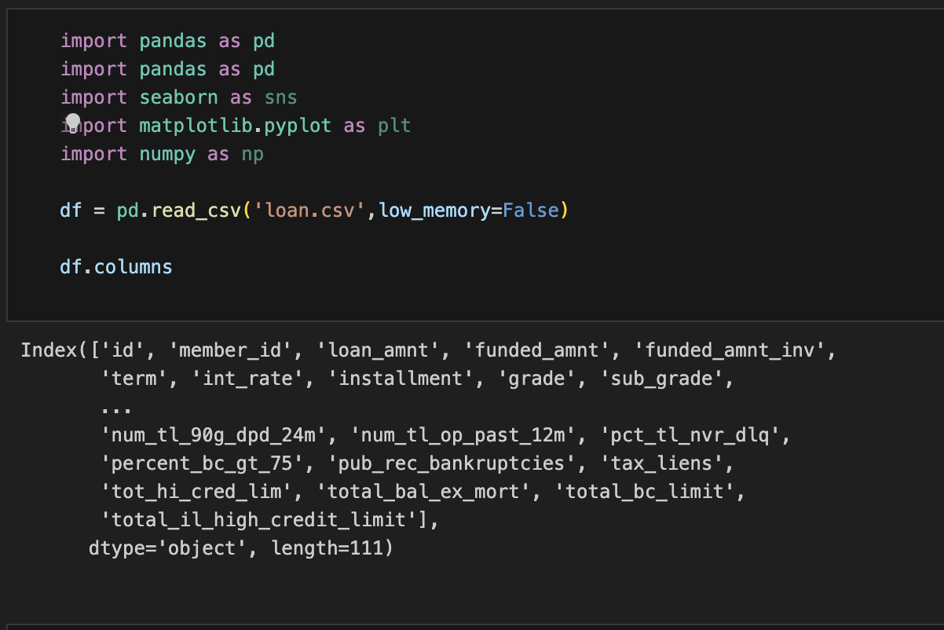
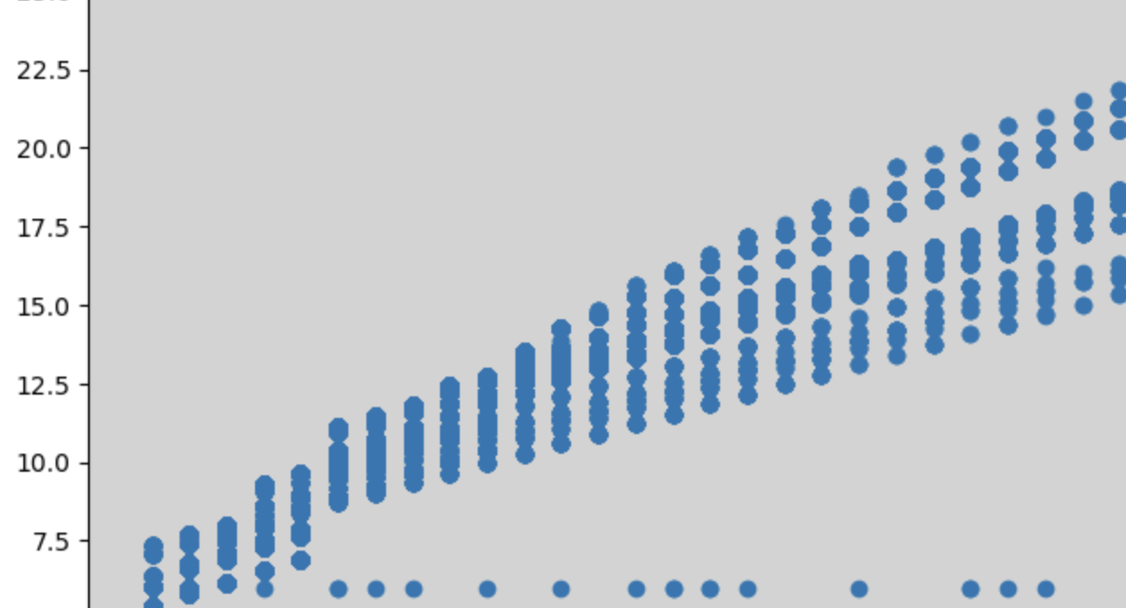
Data Analysis
Data Identification and Cleansing

Slide 5
Data Identification and Cleansing
1. A total of 39717 rows and 111 columns are present in the dataframe.
2. There are 54 columns with all the rows having null values.
3. There are 9 columns with only one single value in it.
4. There are columns with a lot of null values and only with few distinct values.
5. A total of 47 columns have been renamed.
6. 7 columns have been cleansed from objects to strings and int/float.

Slide 6
Chart

Slide 7




Walt Disney
The way to get started is to quit talking and begin doing.

Slide 8





Team
Name
Name
Name
Name
Name
Title
Title
Title
Title
Title

Slide 9
Timeline
To start a presentation, go to the Slide Show tab, and select From Beginning.
01
To display Presenter view, in Slide Show view, on the control bar at the bottom left select the three dots, and then Show Presenter View.
02
During your presentation, the speaker notes are visible on your monitor, but aren't visible to the audience.
03
The Notes pane is a box that appears below each slide. Tap it to add notes.
04
If you don’t see the Notes pane or it is completely minimised, click Notes on the task bar across the bottom of the PowerPoint window.
05

Slide 10
Content
Subtitle
Subtitle
Add text, images, art, and videos.
Add transitions, animations, and motion.
Save to OneDrive, to get to your presentations from your computer, tablet, or phone.
Open the Design Ideas pane for instant slide makeovers.
When we have design ideas, we’ll show them to you right there.

Slide 11
Additional content
Subtitle
Subtitle
Subtitle
Add text, images, art, and videos.
Add transitions, animations, and motion.
Save to OneDrive, to get to your presentations from your computer, tablet, or phone.
Open the Design Ideas pane for instant slide makeovers.
When we have design ideas, we’ll show them to you right there.
This PowerPoint theme uses its own unique set of colours, fonts, and effects to create the overall look and feel of these slides.
PowerPoint has tons of themes to give your presentation just the right personality.

Slide 12
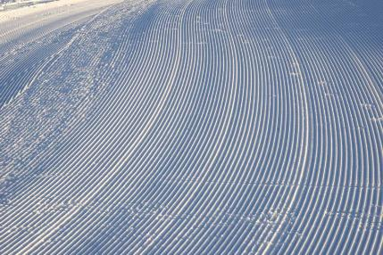


Summary
With PowerPoint, you can create presentations and share your work with others, wherever they are. Type the text you want here to get started. You can also add images, art, and videos on this template. Save to OneDrive and access your presentations from your computer, tablet, or phone.

Slide 13
Thank you
Presenter name
Email address
Website

